Slide 1
Air Quality Monitor
Abdul Hadi
Ahmad Naeem
Mashhood Ijaz
Muneeb Aijaz

Slide 2
Introduction
A software controlled hardware system
Detects different gases and checks air quality
Store with respect to Location
Useful for Environment Monitoring

Slide 3
Functional Requirements
Real time data collection
Database access to compare data
Notify about the Air Quality at a specific location
Notify by the color codes to help identifying the air quality

Slide 4
Non-Functional Requirements
Only admin should be able to access protected data
Database should be able to store more than 5 years of data
Only admin should have the access to add new admins
Classrooms of SEECS UG block should be mapped
Data for each class should be individually accessable

Slide 5
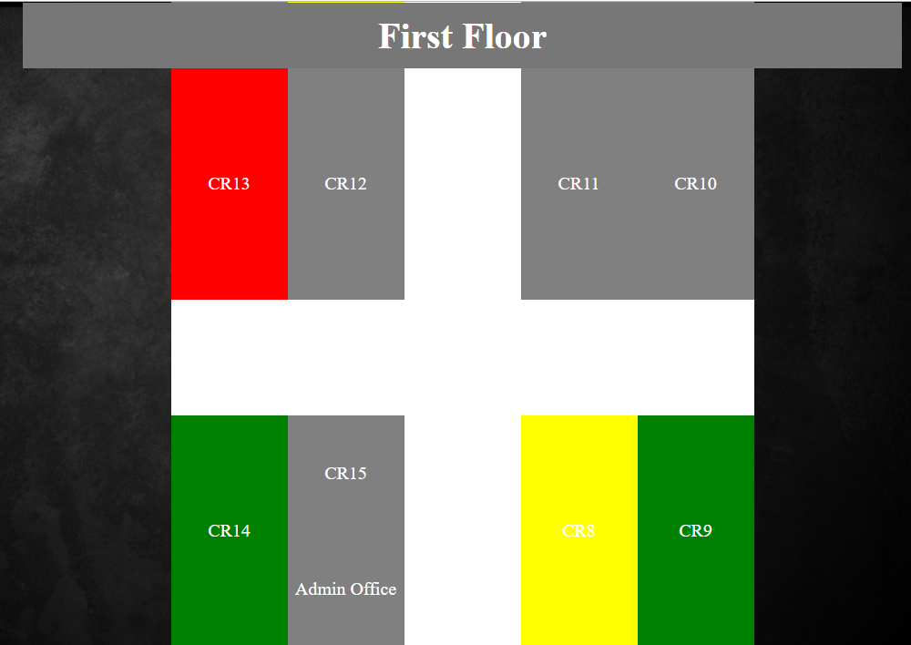
Floorplan

Slide 6
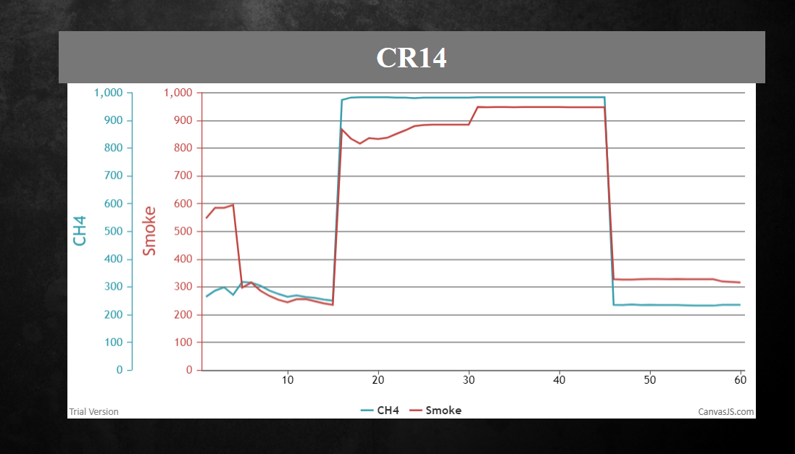
Classroom

Slide 7
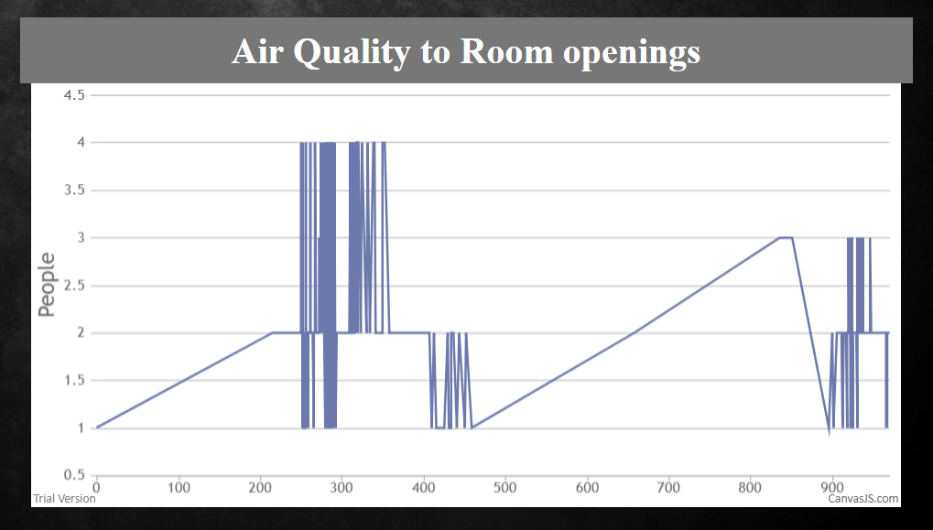
Data Comparison

Slide 8
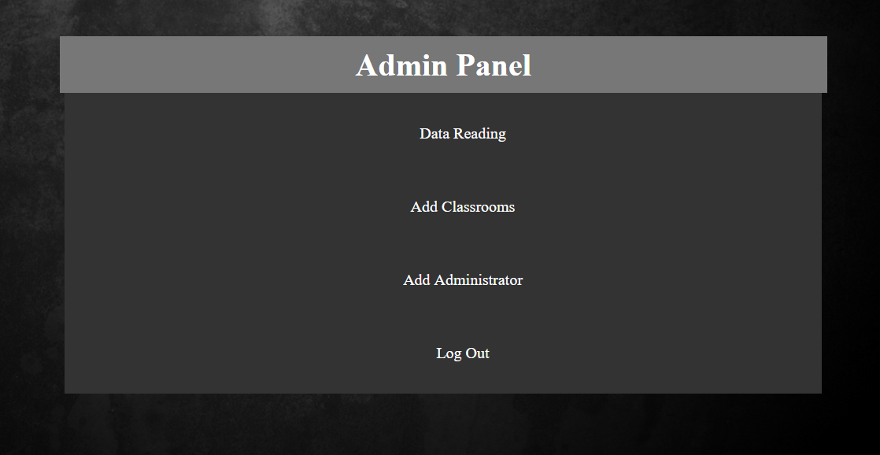
Admin Panel

Slide 9
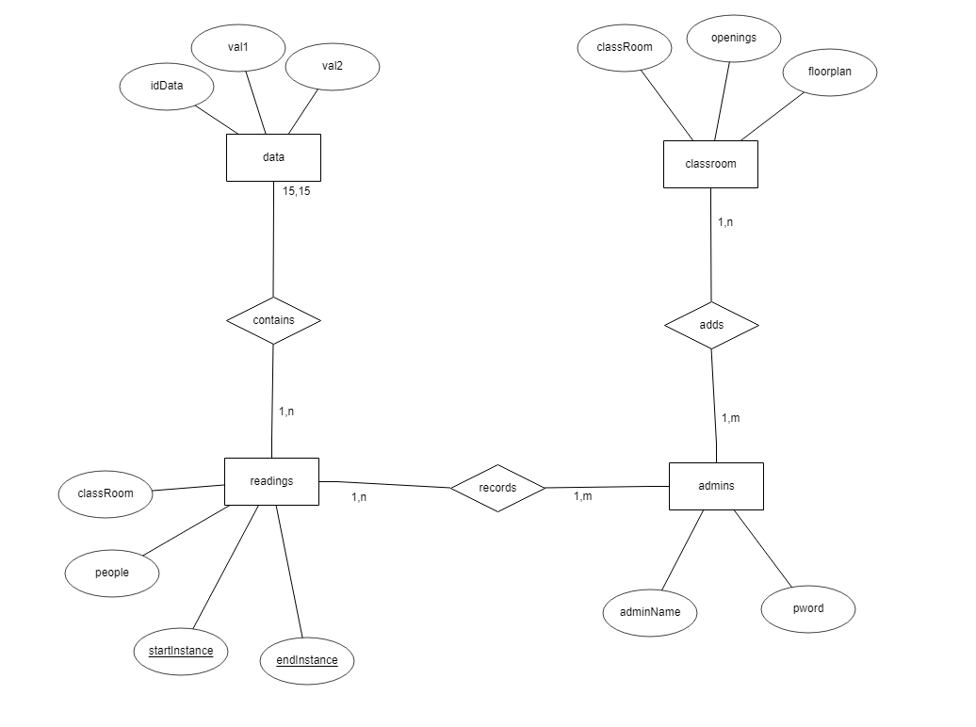
Entity-Relationship Diagram

Slide 10
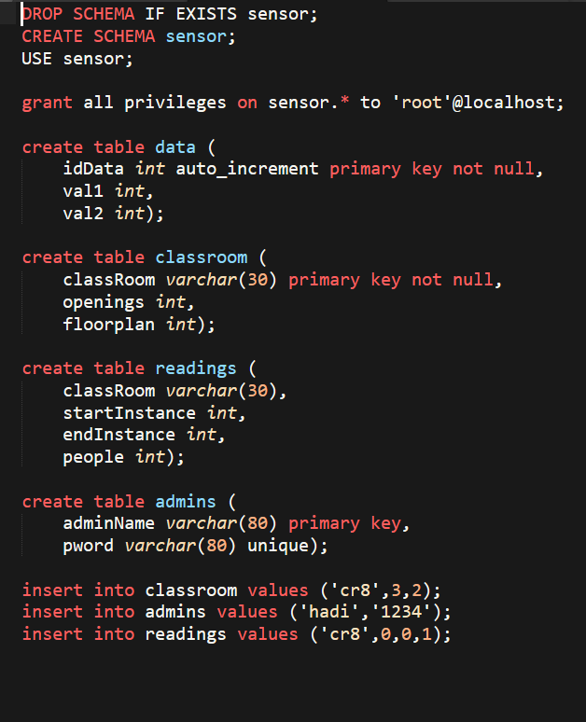
Schema

Slide 11
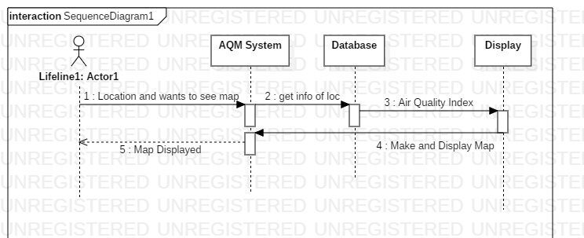
Sequence Diagram

Slide 12
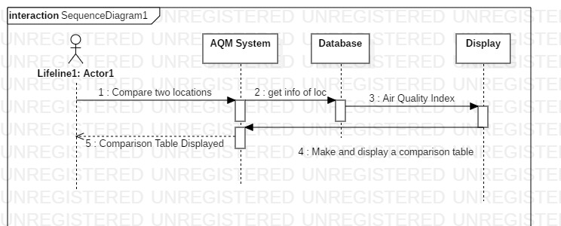
Sequence Diagram

Slide 13
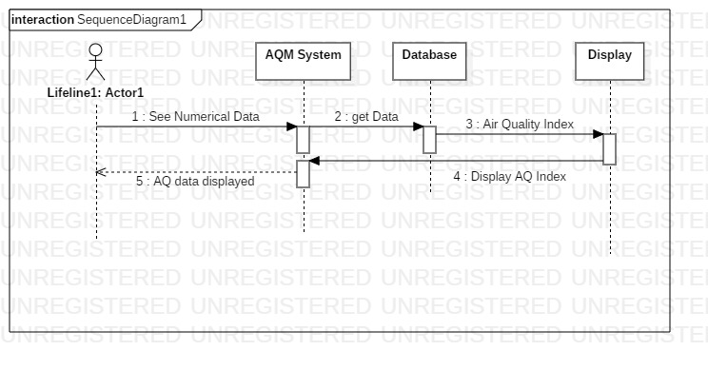
Sequence Diagram

Slide 14
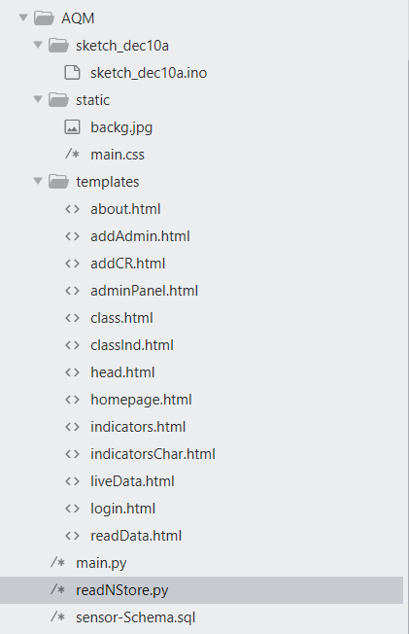
File Structure

Slide 15
Advantages
Can be scaled to a bigger level by adding more sensors
Provides On-time values
Gives values in clusters to avoid small variation errors

Slide 16
Limitations
Not designed for remote data collections
Based on values from 2 sensors, for now

Slide 17
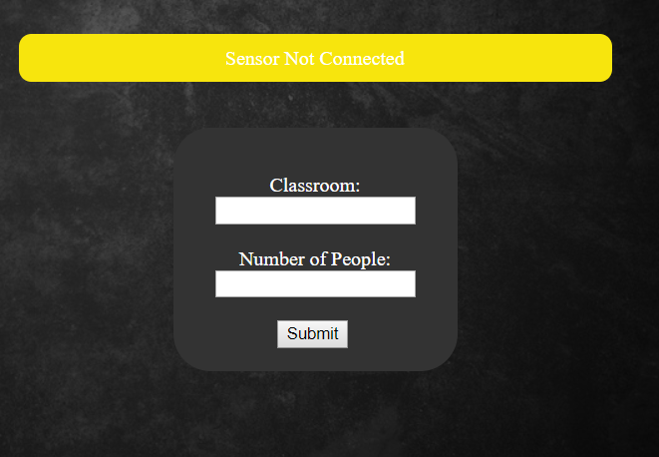
Test Cases and Data Validation

Slide 18
Dependencies
JavaScript – CanvasJS
ArduinoIDE
Python - Serial
Python - Flask
MySQL Server

